Slide 1
“My employer does not have a job title for archivist:” Preliminary results of an archival climate survey
Ashley Todd-Diaz, Towson University
Kari Smith, Massachusetts Insititute of Technology (MIT)
Nance McGovern, Massachusetts Institute of Technology (MIT)
SAA Research Forum 2020

Slide 2
Motivation for this study
Research Forum 2019
Positioning of archives
Corollation between Univ. Archives and Records Mgmt
Discussion and lit review
Radical collaboration
Professional identity
Survey
Professional identity
Perception
Organizational structure
Organizational shifts
Radical collaboration
Notes:
SAA RF last year
Nancy, Ashley
Kari's presentation

Slide 3
Background
At many institutions, archival coursework is nested within library schools as a track or specialization.
In the U.S., most academic archives exist organizationally and/or physically within the academic library.
Some library administrators have stated there is no ideal place in the library for the archives (Todd-Diaz, 2019).
Strong team identification between siloed departments in an organization complicates negotiations regarding resources, knowledge sharing, and group power and status (Cyert & March, 1963/2010; Zhu, 2016).
Todd-Diaz (2019) found that many library administrators have little to no archival experience and do not identify as archivists.
According to social identity theory, an individual's sense of self is tied to the status of the various groups to which they belong, including their profession (Tajfel & Turner, 1979).
Smith (2019) found that there is a correlation between University Archivist positions and Records Management responsibilities at academic institutions.
McGovern (2018) emphasizes the value that all domains and professions bring to digital practice and that professional inclusion is important for collaboration.

Slide 4
Methodology
Online survey deployed May-June 2020 (n=452)
Questions relating to:
Professional identity
Job title and responsibilities
Perception of role within the organization
Organizational structure
Organizational change

Slide 5
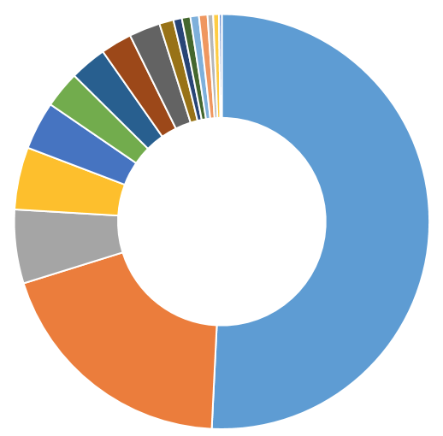
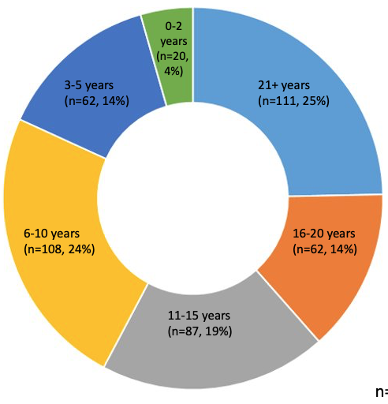
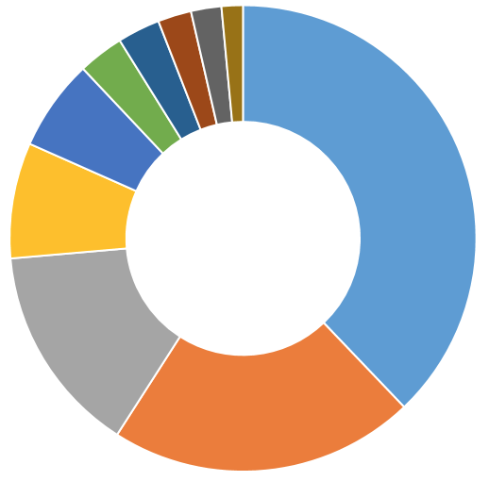
Demographics
Historical Society
(n=13, 3%)
ICA (n=14, 3%)
COSA (n=20, 4%)
SAA
(n=356, 78%)
SSA (n=22, 5%)
Public Library
(n=13, 3%)
NAGARA (n=28, 6%)
NWA (n=30, 6%)
Religious
(n=17, 4%)
NEA
(n=60, 13%)
Museum
(n=22, 5%)
Sector
Academic (n=230, 51%)
Years in the archival field
MAC
(n=76, 17%)
Corporate (n=26, 5%)
Memberships
MARAC
(n=138, 31%)
Government (n=88, 19%)
Other
(n=201, 44%)
Less than 3%
Non-profit | 11
Unidentified | 11
Arts | 5
Research | 3
Private | 3
Retired/unemployed | 3
Library | 3
Independent/consultant | 2
Medical | 2
K-12 School | 1
Common "Other" answers
Association of Certified Archivists | 33
Society of California Archivists | 23
Archivists Round Table of Metropolitan New York | 10
Conference of Inter-Mountain Archivists | 10
Association of Moving Image Archivists | 8
Society of Rocky Mountain Archivists | 8
Rare Book and Manuscript Section (RBMS) of ACRL | 7
Archivists for Congregations of Women Religious | 6
Delaware Valley Archivists Group | 6
Society of Florida Archivists | 6

Slide 6
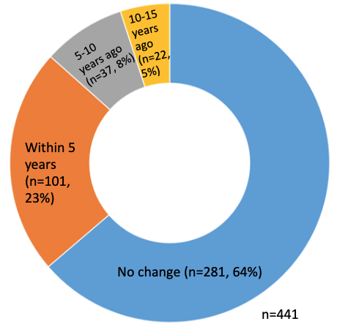
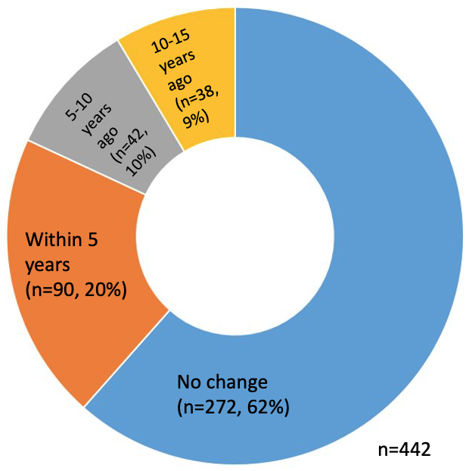
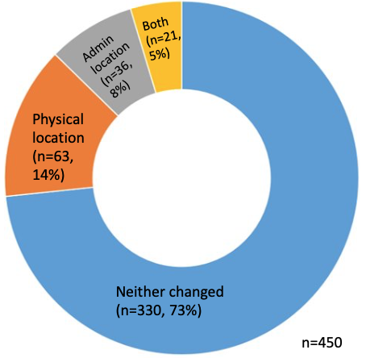
Changes
Job title
(same
responsibilities)
Unit title
Location

Slide 7
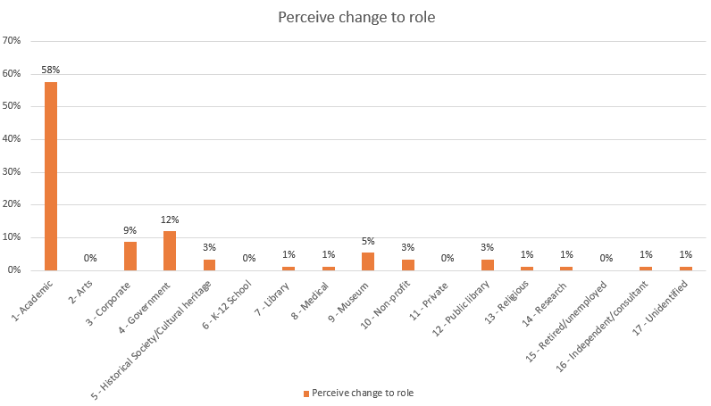
Perceived role change following institutional changes
Yes
(n=92, 32%)
No
(n=199, 78%)
n=291

Slide 8
Impact of changes
"The dept. is sometimes seen as separate from the library because of the physical separation."
"Now that we have our own space, we have a stronger physical presence on campus."
"If anything, I think leadership values me more."
"The department we were in before understood us and our work. I feel like [the new department] doesn't even know we exist, let alone what we do or how to let us be part of the department."
"I have not been seen as an equal to the other library managers."
"I had been perceived as an independent agent who happened to work within the library. I am now perceived as a member of the library, working to fulfill the library's mission."
"My role changes depending on who the manager is."
"I think being with Education provided the folks in that division with a different perception of how the Library & Archives and its staff can operate within the institution, but now that we are back with Curatorial, the mission has shifted back to primarily that of serving the institution itself rather than our external audiences."
"Can not discuss without trauma."

Slide 9
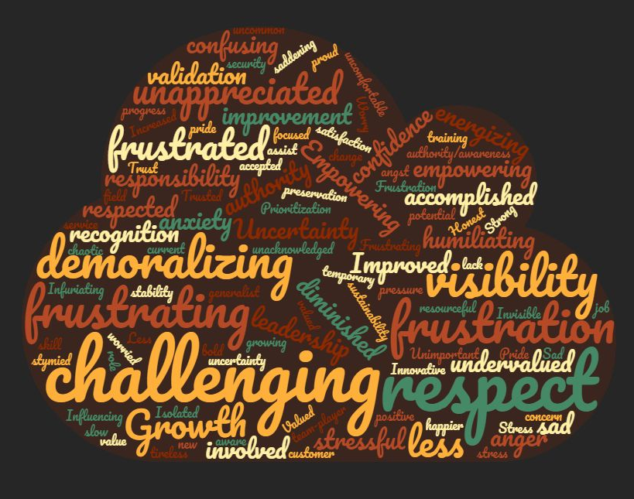
Three Words about the Changes

Slide 10
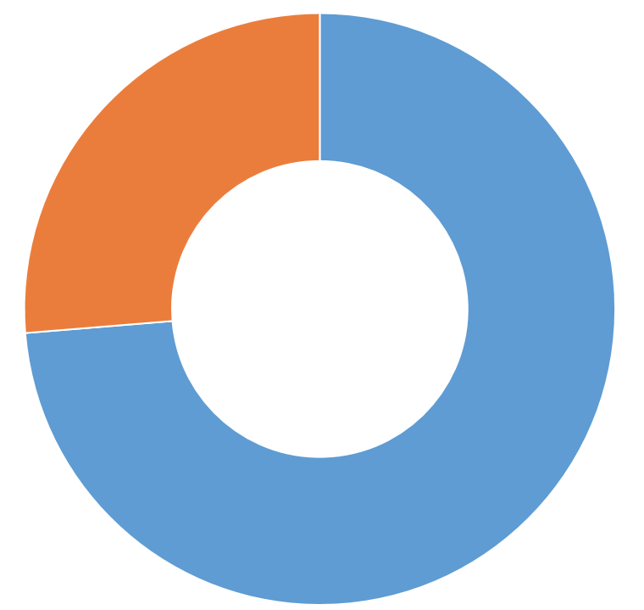
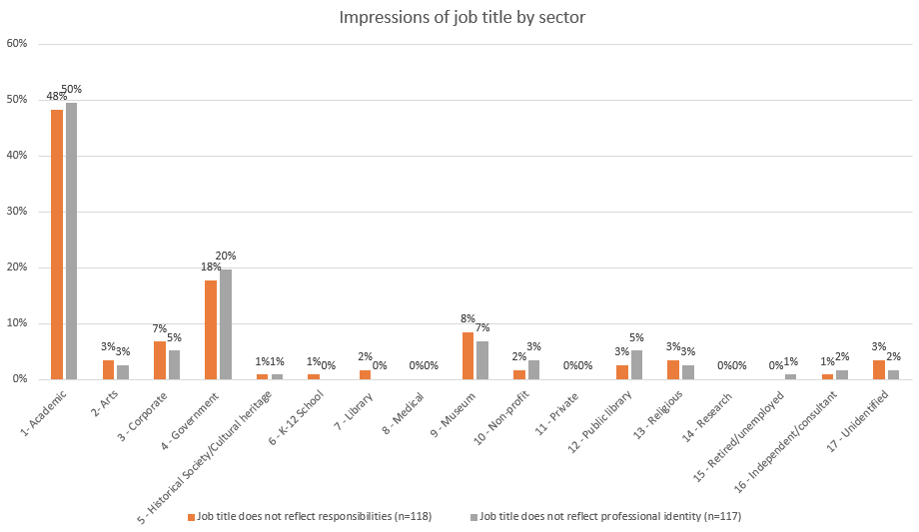
Does job title reflect professional identity?
Does job title reflect job responsibilities?​
No
(n=118,
26%)
Yes (n=329, 74%)
n=447
No
(n=117,
26%)
Yes (n=328, 74%)
n=445

Slide 11
Mismatched job title and professional identity
"I wish I could get the term 'archibrarian' to happen."
"It was made up on the spot by my department head when I asked for business cards."
"How does a numbered position reflect anyone as an identity?"
"The title is confusing to everyone."
"No one knows what the title means."
"The terms 'archivist' and 'curator' are often romanticized, and widely misunderstood."
"it's easier to explain what I do as a 'librarian.'"
"For now it is adequate."
"I changed it myself and no one objected."
Notes:
Please explain how you believe your job title does or does not reflect your professional identity.

Slide 12
Do you have a secondary professional identity?
No (n=234, 53%)
Yes (n=207, 47%)
n=441

Slide 13
[word cloud re: secondary identity)

Slide 16
Next Steps
Further analyze the qualitative data
Respondents (26%) who feel a disconnect with their job title
Respondents who don't identify with the job title "archivist"
Prepare Research Report for SAA Research Forum
Identify similar studies by other researchers and consider that data as it intersects with our study

Slide 17
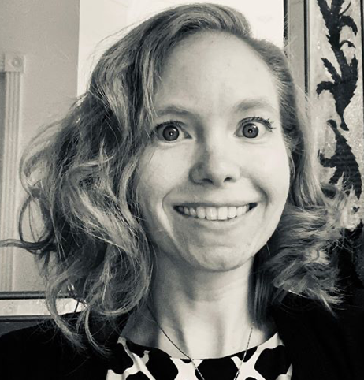
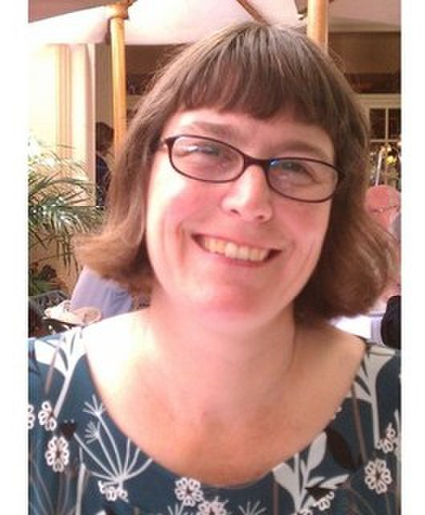
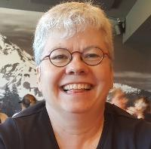
Thank you!
Ashley Todd-Diaz
Towson University
Kari Smith
Massachusetts Institute of Technology (MIT)
Nance McGovern
Massachusetts Institute of Technology
(MIT)

Slide 18
References
Cyert, R., & March, J. G. (2010). A behavioral theory of the firm. New Jersey, NJ: Prentice. (Original work published 1963.)
McGovern, N. Y. (2018) “Radical collaboration and research data management: An introduction,” “Radical Collaboration: An Archival View,” and “Forward Together.” Research Library Issues, 296.
Tajfel, H., & Turner, J. (1979). An integrative theory of intergroup conflict. In W. G. Austin & S. Worchel (Eds.), The social psychology of intergroup relations (pp. 33–48). Monterey, CA: Brooks-Cole.
Todd-Diaz, A. (2019). Archives in libraries: The impact of a parent-child relationship on corporate identity and user perception (Doctoral dissertation). Available from ProQuest Dissertations & Theses Global. (2312284161).
Zhu, Y.-Q. (2016). Solving knowledge sharing disparity: The role of team identification, organizational identification, and in-group bias. International Journal of Information Management, 36(6, Part B), 1174–1183.

